Slide 1

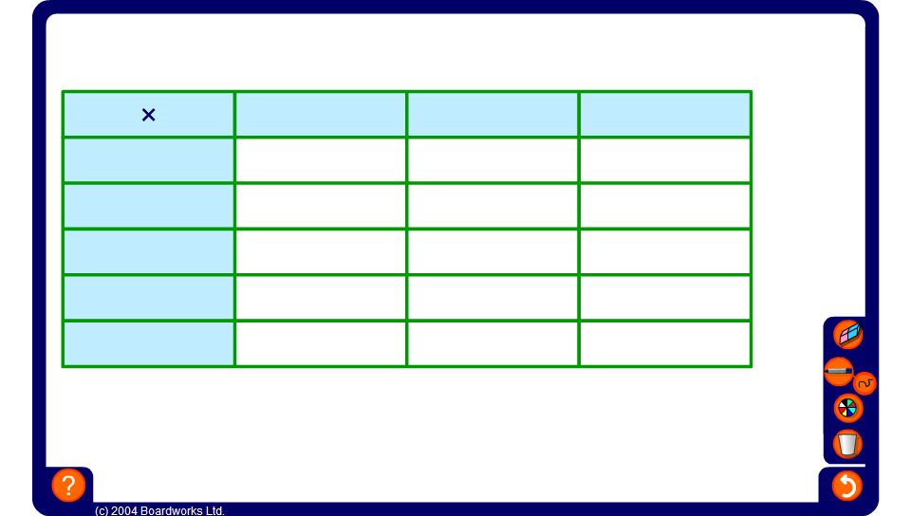


Algebraic multiplication square
Notes:
Complete this activity as a group exercise.
Reveal the expressions in the blue cells and ask pupils to find the expressions in the white cells by multiplying.
Ask pupils how the multiplications could be written using brackets.

